Slide 1
FYP Proposal Defense BLACK PEARL
GROUP MEMBERS
S.No. | Enrollment # | Student Name
1 | 02-131192-044 | Muhammad Umer Adeem
2 | 02-131192-052 | Sajjad Ahmed
3 | 02-131192-017 | Muhammad Husnain

Slide 2
Table of Contents
Introduction
Background
Problem Statement
Proposed Solution
Project Scope
Work Breakdown Structure / Gantt Chart
References

Slide 3
Introduction
The project is related to the field of Cyber security.
Specialized in automatic Web Application Penetration Testing.
The application will conduct:
Reconnaissance.
Enumeration & Scanning.
Vulnerability Scanning.
Cross checking of any identified vulnerability.

Slide 4
Background
Previous FYPs:
OWAPT (2021)
Reconnaisance: Crawling
Identify Vulnerabilities:
SQLi
Login Sequences
Buffer Overflow
HTTPparameter pollution
Content Spoofing
URL Manipulation
XSS
Clickjacking
Reporting

Slide 5
Background
SWAPTT
Reconnaisance: Crawling, Hakrawler
Scanning: Scanning for Open Ports
Identify Vulnerabilities:
SSH bruteforce
Subdomain Takeover
CVE-41773
CORS
XSS
Proxyshell
Verb Tampering
SQLi
Reporting

Slide 6
Background
Some Vulnerability Scanners
Burp Suite's Active Scanner:
Scans for a wide variety of vulnerabilities.
Large number of False positives.
Pro: 449$ per year.
Enterprise: 8000$ per year.
Nessus:
Scans limited web application vulnerabilities, more focused on network vulnerabilities.
2000$ - 3000$ per year.

Slide 7
Problem Statement
The Problem:
Web Applications are one of the main targets of adversaries. Many events have been reported, which led to complete compromise of confidentiality, integrity, availability of the Organizations because of Web vulnerabilities.
Organizations need to conduct vulnerability scanning and Penetration testings on there own.
Existing Solutions are scanning for limited vulnerabilities, generate many false positives and are quite expensive.

Slide 8
Proposed Solution
Features of the project
Reconnaissance:
Subdomain Enumeration
Crawling
Fingerprinting
Discover from web archive
Enumeration & Scanning:
Scan for Open Ports, Discover services running on them and if they are vulnerable to an attack.
Finding hidden files and Directories and crawling again on discovered files if needed.
Vulnerability Scanning & exploitation:
XSS
SQLi
SSTi
Command Injections
Host Header Injections
Open Redirect
SSRF
Subdomain Takeover.
CORS
Cloud Bucket Misconfigurations
403 bypass
Clickjacking
RFI
LFI
Information Disclosure
Google API Misconfiguration
CSRF

Slide 9
Proposed Solution
Features of the project (Continued)
Cross Checking for any identified Vulnerability to minimize false positives.
Fast Vulnerability Scanner Engine:
Scanning for famous vulnerabilities not covered in previous section.
Scanning for vulnerabilities in outdated 3rd party components integrated with websites.
Zero False Positives.
E.g.
Get: <base url>/locale/?memory=/etc/passwd
Match: “:root:”
Reporting

Slide 10
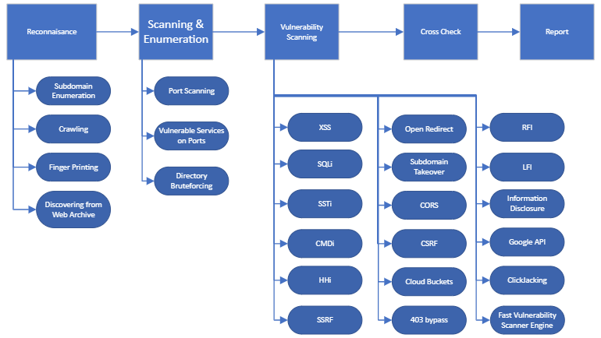
Proposed Solution
Methodology

Slide 11
Proposed Solution
Technologies to be used
HTML, CSS, JS for front end.
Django for backend.
Sustainable Development Goals Mappings
Goal 8: Decent Work and Economic Growth.
Goal 9: Industry, Innovation and Infrastructure.

Slide 12
Project Scope
The goal is to provide:
An automated Web Application Penetration Testing Software.
Recon a web domain to find many of the information related to it, which only an experienced hacker can harvest.
Testing each port of a website.
Testing many different types of vulnerabilities as discussed.
Fast Vulnerability Scanner Engine.
Having minimum false positives.
Reports.

Slide 13
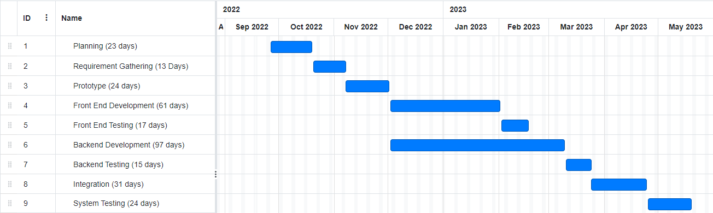
Gantt Chart

Slide 14
References
[1] OWASP TOP 10 SECURITY VULNERABILITIES - 2020
OWASP Top Ten Web Application Security Risks | OWASP
[2] TENABLE’S NESSUS
Nessus
[3] PORTSWIGGER’S BURP SUITE
Burp Suite

